Slide 1

Dynamic Medical Ontologies
-By
Megha Nagabhushan
Rohithkumar Nagulapati

Slide 2
Introduction
Motivation
In present day medical science, the published literature, in particular medical journals provide the primary medium of data source for new medical findings and research. This data is raw and cannot be comprehended by people outside medical field.
Objective
The main objective of this project is to extract medical data from a reliable source and apply natural language techniques to extract relationships. We are also going to cluster and classify the data for topic discovery and represent the information in the form of an ontology.

Slide 3
Data Collection
We are using the PubMed API by using the keyword, “obesity” on the PubMed database.
PubMed comprises more than 27 million citations for biomedical literature from MEDLINE, life science journals, and online books.
We selected abstract data from research papers for our project.
We are using abstracts from three different research papers on obesity for our project.

Slide 4
System Design
Dataset
OpenIE
Triplets
<S,P,O>
Triplets with important words
K- means
Clustering
(triplet similarity)
Lemmatization and stop word removal
Tf-idf
Important words in the dataset
LDA
K-means clusters
Question Answering
Interface
Ontology Generation
Classes
Individuals
Object properties
Data properties
Triplets
Topic1,cluster1
.
.
.
Topic10,cluster10

Slide 5
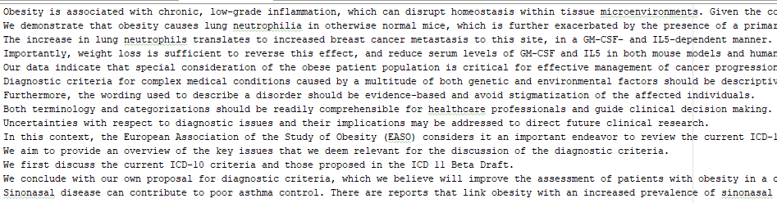
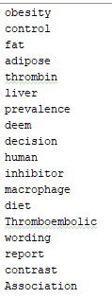
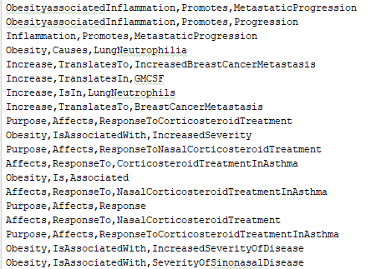
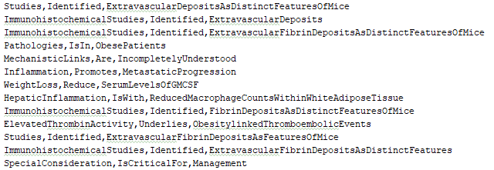
Dataset
(3 abstracts)
Tf- idf words (50 words)
Triplets containing tf-idf words(110 triplets)
Triplets from the dataset (173 triplets)

Slide 6
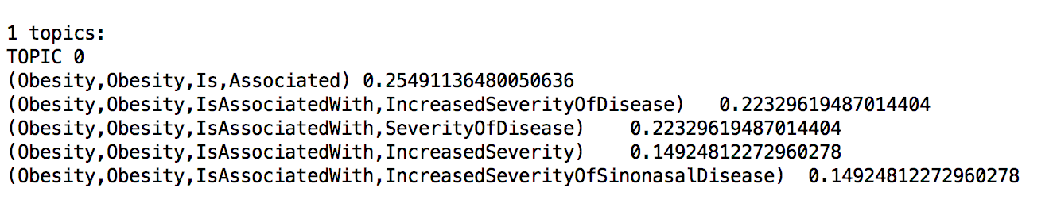
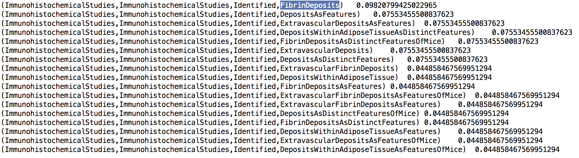
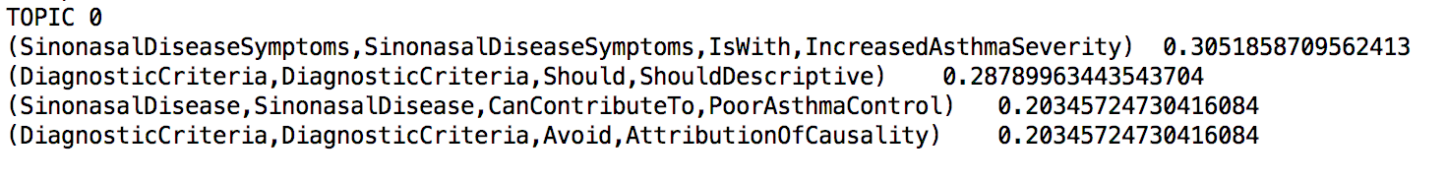
(Obesity,Obesity,Causes,LungNeutrophilia) (Obesity,Obesity,IsAssociatedWith,IncreasedSeverity) (LinkObesity,LinkObesity,IsWith,IncreasedPrevalenceOfSinonasalDisease) (Obesity,Obesity,IsAssociatedWith,IncreasedSeverityOfSinonasalDisease) (Obesity,Obesity,Is,Associated) (Obesity,Obesity,IsAssociatedWith,SeverityOfDisease) (Obesity,Obesity,IsAssociatedWith,SeverityOfSinonasalDisease) (Obesity,Obesity,IsAssociatedWith,Severity) (Obesity,Obesity,IsAssociatedWith,IncreasedSeverityOfDisease)
Cluster 1
(ImmunohistochemicalStudies,ImmunohistochemicalStudies,Identified,Deposits)
(ImmunohistochemicalStudies,ImmunohistochemicalStudies,Identified,ExtravascularFibrinDeposits) (ImmunohistochemicalStudies,ImmunohistochemicalStudies,Identified,ExtravascularDepositsAsFeatures) (ImmunohistochemicalStudies,ImmunohistochemicalStudies,Identified,DepositsAsDistinctFeatures) (ImmunohistochemicalStudies,ImmunohistochemicalStudies,Identified,DepositsAsFeatures) (ImmunohistochemicalStudies,ImmunohistochemicalStudies,Identified,DepositsWithinAdiposeTissue) (ImmunohistochemicalStudies,ImmunohistochemicalStudies,Identified,FibrinDepositsAsFeatures) (ImmunohistochemicalStudies,ImmunohistochemicalStudies,Identified,ExtravascularFibrinDepositsAsFeatures)
Cluster 2
. .
.
(SinonasalDisease,SinonasalDisease,CanContributeTo,AsthmaControl) (DiagnosticCriteria,DiagnosticCriteria,Should,ShouldDescriptive) (Disease,Disease,CanContributeTo,PoorAsthmaControl) (Disease,Disease,CanContributeTo,AsthmaControl) (SinonasalDiseaseSymptoms,SinonasalDiseaseSymptoms,IsWith,IncreasedAsthmaSeverity) (SinonasalDisease,SinonasalDisease,CanContributeTo,PoorAsthmaControl) (DiagnosticCriteria,DiagnosticCriteria,Avoid,AttributionOfCausality)
Cluster10
LDA on individual clusters
K-means clusters (K=10)

Slide 7
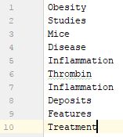
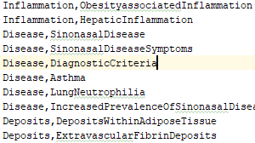
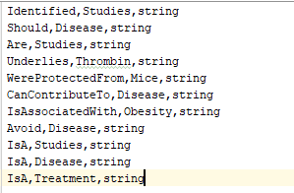
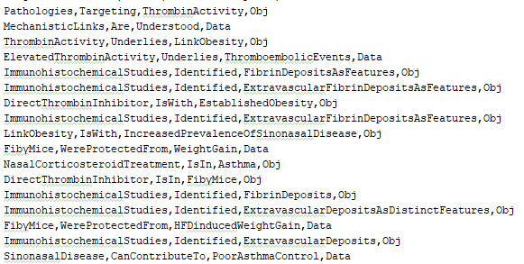
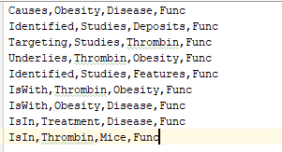
Classes -10
Individuals - 29
Data Properties - 9
Object Properties - 11
Triplets - 29

Slide 8
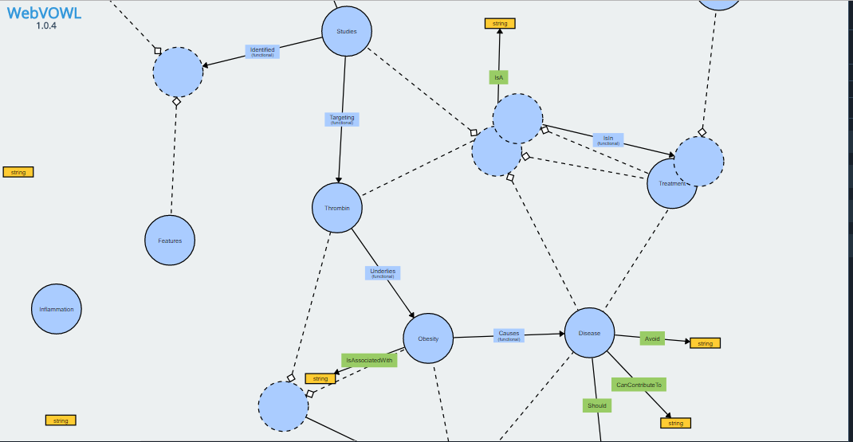
Visualization

Slide 9
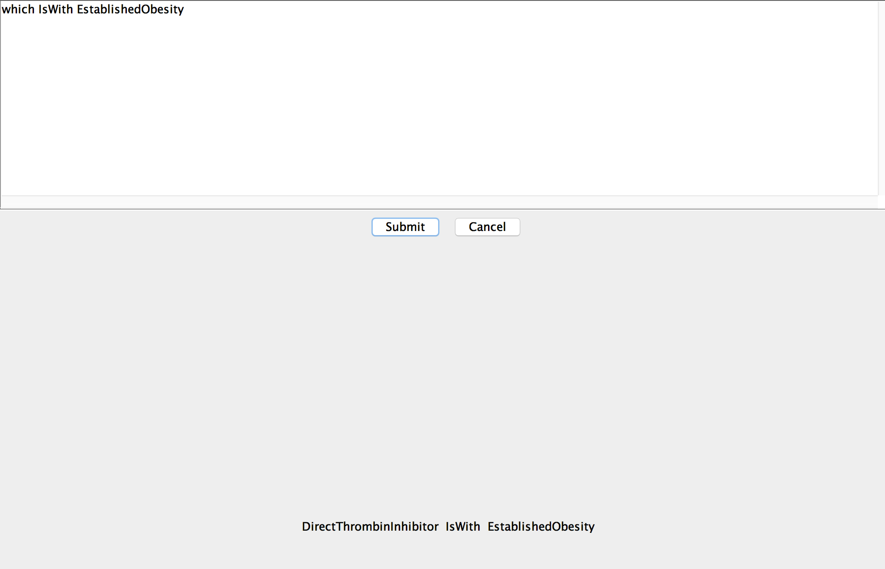
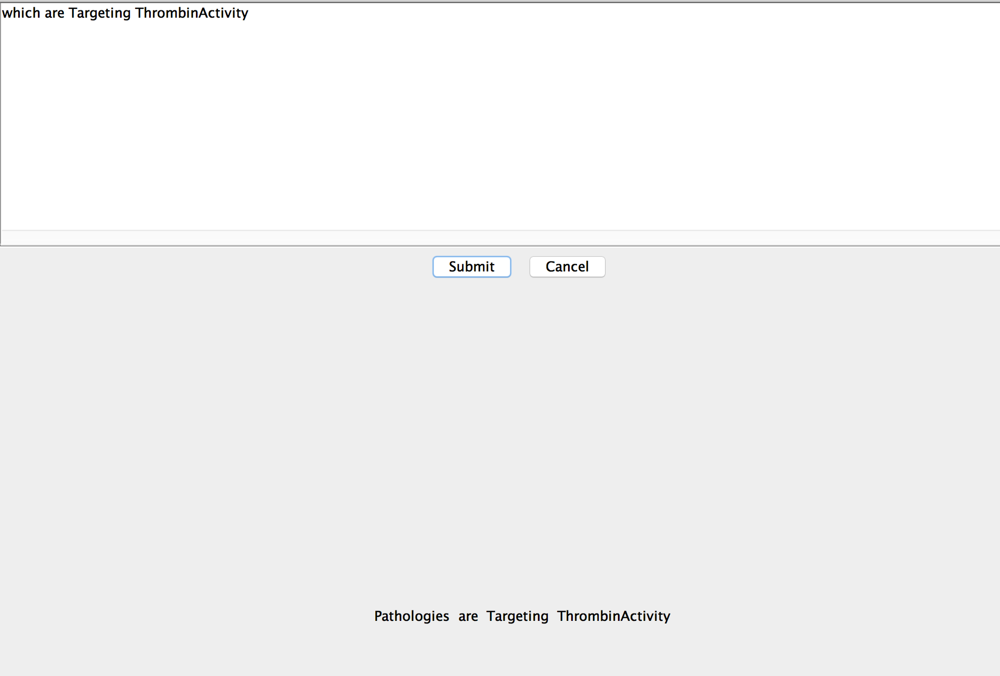
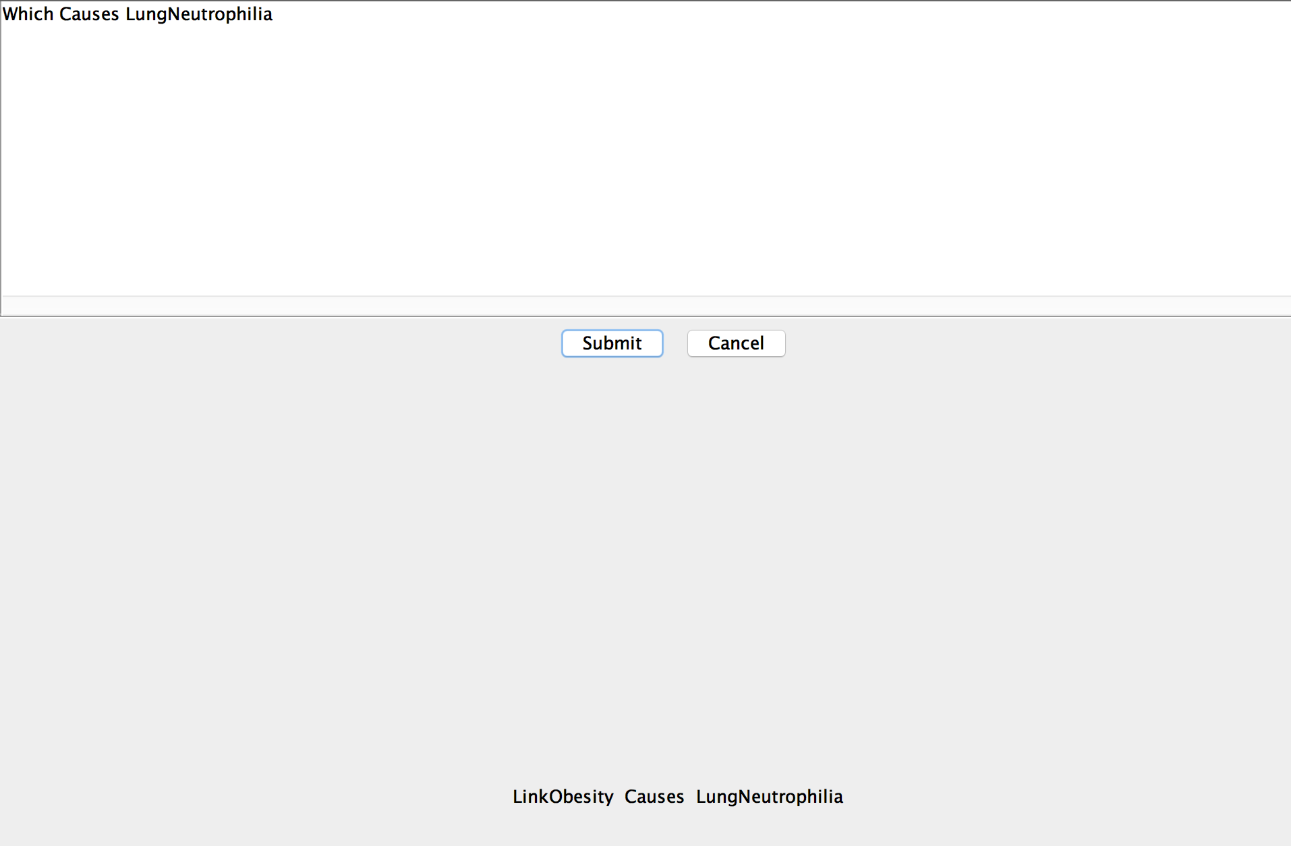
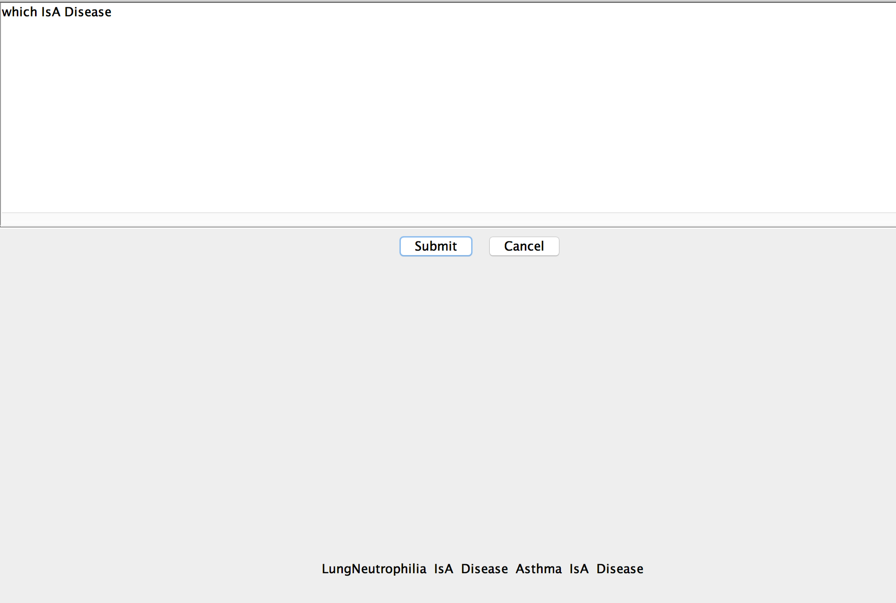
Querying

Slide 10

Future Work
Using MetaMap for identifying the medical terms.
Creating ontologies for all the sections of the Research papers.
Combining different ontologies belonging to similar topics.

